Slide 1
METRO INTERSTATE PREDICTION
By: Aditi Pagey & Srujana Gundam

Slide 2
Problem Statement - Metro Interstate Prediction
The goal of this project is to build a regressive prediction model using multiple machine learning techniques and to use a template to document the end-to-end stages. We're trying to forecast the value of a continuous variable with the Metro Interstate Traffic Volume dataset, which is a regression issue.
Based on the given dataset , I had to do the prediction based on the following parameters:
Whether it was a holiday
Temperature
Date
Time
Clouds(%)
Weather

Slide 3
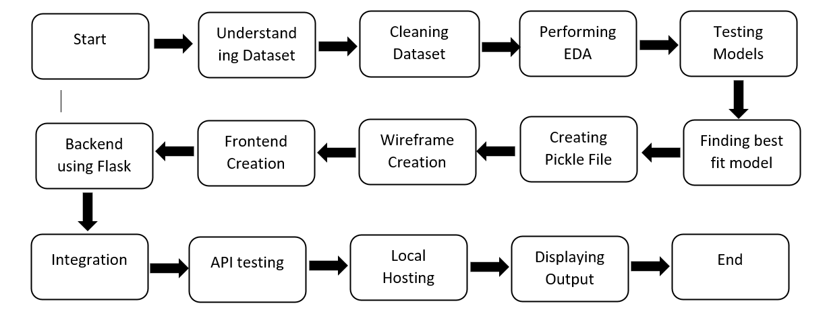
Architecture

Slide 4
Understanding the Dataset: Load the dataset and understand the various parameters given in it and what is their significance and units of the various parameters.
Cleaning the dataset: Clean the dataset and checked if it has any null values or rows which are not complete or have any garbage values.
Exploratory Data Analysis (EDA): to find out which parameters provide insights to understand the data better.
Change the data columns to categorical and numerical values for the better training and performance of the model
Pre-processing – analyse which columns aren’t useful for the output dependent parameter (as the model is regressive model)
Drop the columns which aren’t providing much insights for the understanding the dependency of the output variable on it.

Slide 5
4. Testing Models: Testing on various regression models to find the best fit for the dataset by seeing the accuracy of each model after training.
5. Creating a pickle file: It serializes the object first before writing it to file. Pickling is a way to convert a python object (list, dict, etc.) into a character stream. The idea is that this character stream contains all the information necessary to reconstruct the object in another python script.
6. Wireframe Creation: It is a schematic or blueprint that is useful for helping you think and communicate about the structure of the software or website you're building.
7. Frontend Creation: This is the software program or website which the user uses to interact. Create the frontend by using tools according to convenience.
8. Backend Creation: Backend is the server-side of the website. It stores and arranges data, and also makes sure everything on the client-side of the website works fine. Create the frontend by using tools according to convenience.
9. Integrating of backend and frontend: Write functions in the backend that take the model as input from the pickle file and give the predicted output.

Slide 6
Result
We learned how to approach a problem and optimal ways to divide tasks for easier understanding and completion of the work.We also learned about new technologies and modules while debugging error.While working on this project we also expanded our network which in turn helped us to learn importance of clear communication .

Slide 7
Future Scope
Predicting the traffic for a given time , day and month will help the traveller understand when he/she should travel in order to avoid traffic as the number of vehicles are increasing in a large volume.
This model can be further enhanced with real time data set values with regular updation to increase it prediction accuracy (currently 93%) .
More features can be added to the user interface to track previous start to end destination travel time, date, day etc so that user can plan their day better, section to add the recent journey experience details so that they can be updated to the dataset and model will be trained against more varied dataset and will be up to date daily.

Slide 8
Thank You!

